Slide 1
R square VS Adjusted R square

Slide 2
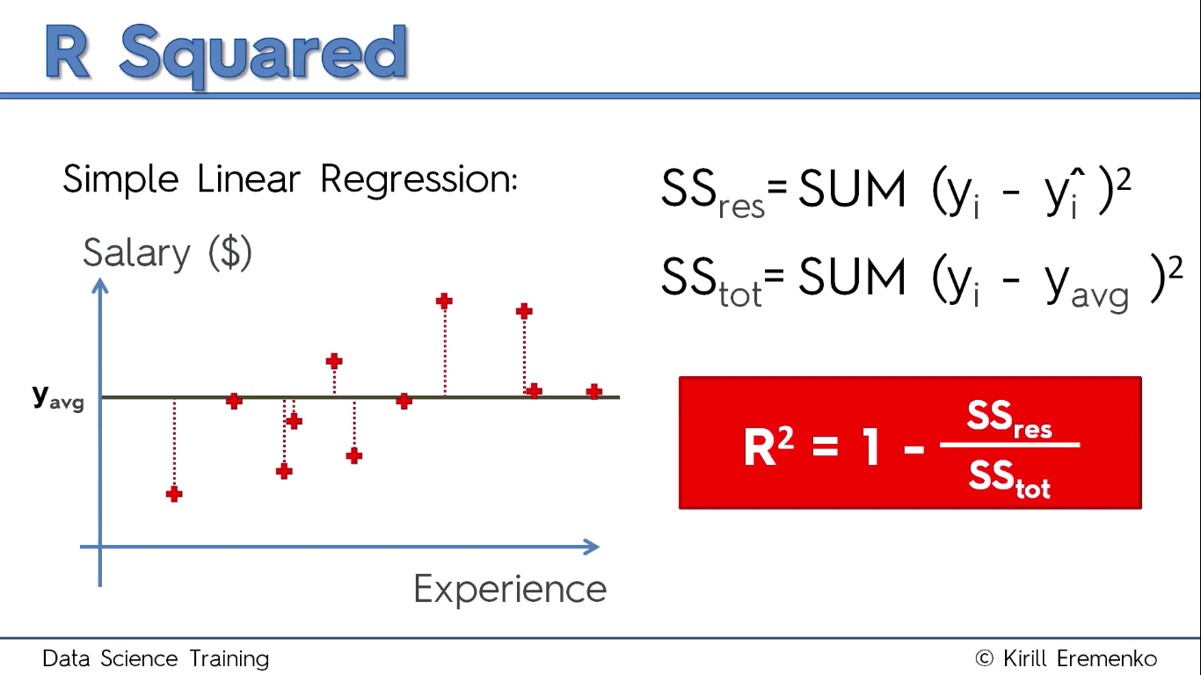
R squared intuition

Slide 3
Goal : find a line with SSres as low as possible
Value of R^2 generally lies between 0 and 1
The more closer the R^2 is to 1 the better our line is.
Why we square ? To deal with positive values and to deal with outliers , however we can use power of 4 or 6 or etc. but square is convention and that is widely accepted hence we will use that for now.
R^2 can take negative values (if our data fits worstly to our linear regression)

Slide 4
Problems with R²
As number of independent values increase the value of R^2 will either increase but will never descrease.
Hence we will not know how good of a influence does this newly added independent variable has on our dependent variable.
Reason for this is that any independent variable has tendency of slightly correalation with the dependent variable. This might help reducing the SSres value hence the value of R^2 increases.
To overcome this we use adjusted R^2

Slide 5
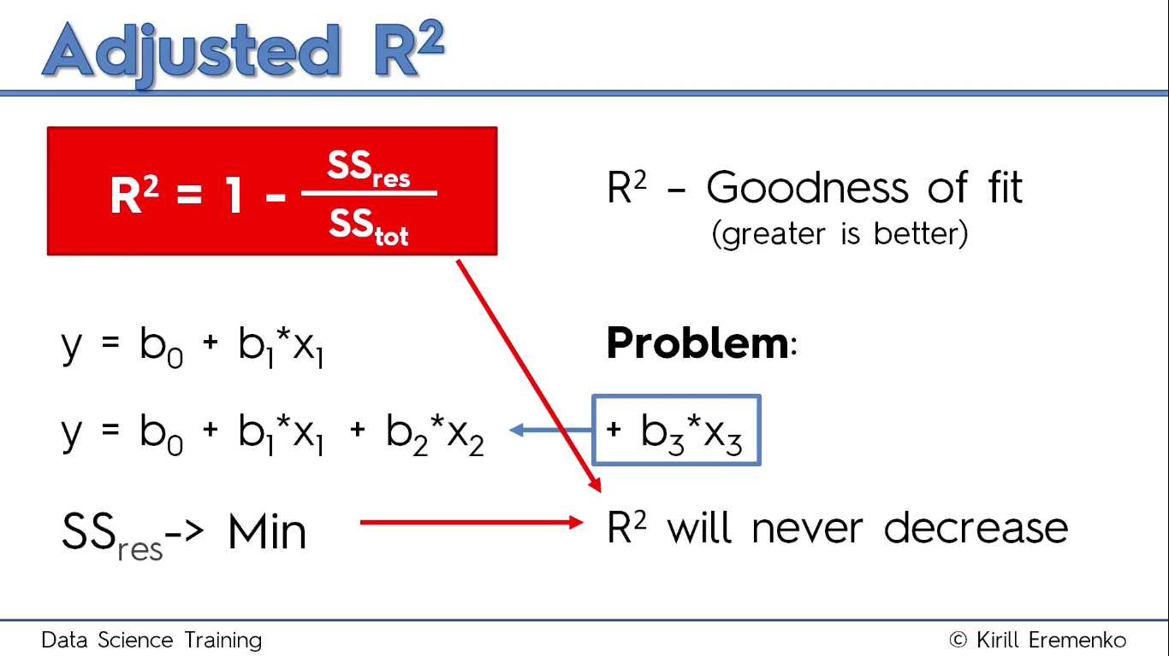

Slide 6
Adjusted R²
Adjusted R^2 deals with additional independent variables.
This r squared value tend to penalize the value of the rsquare if our choice of independent variable wasn’t good (i.e independent variable had no effect on dependent variable)
Also the bias of R SQUARE to not to decrease is handled pretty well in this adjusted R SQUARED method.

Slide 7
Difference
The adjusted R-squared is a modified version of R-squared that has been adjusted for the number of predictors in the model. The adjusted R-squared increases only if the new term improves the model more than would be expected by chance. It decreases when a predictor improves the model by less than expected by chance. The adjusted R-squared can be negative, but it’s usually not. It is always lower than the R-squared.

Slide 8
R-squared or R2 explains the degree to which your input variables explain the variation of your output / predicted variable. So, if R-square is 0.8, it means 80% of the variation in the output variable is explained by the input variables. So, in simple terms, higher the R squared, the more variation is explained by your input variables and hence better is your model.
However, the problem with R-squared is that it will either stay the same or increase with addition of more variables, even if they do not have any relationship with the output variables. This is where “Adjusted R square” comes to help. Adjusted R-square penalizes you for adding variables which do not improve your existing model.
Hence, if you are building Linear regression on multiple variable, it is always suggested that you use Adjusted R-squared to judge goodness of model. In case you only have one input variable, R-square and Adjusted R squared would be exactly same.
Typically, the more non-significant variables you add into the model, the gap in R-squared and Adjusted R-squared increases.

Slide 9
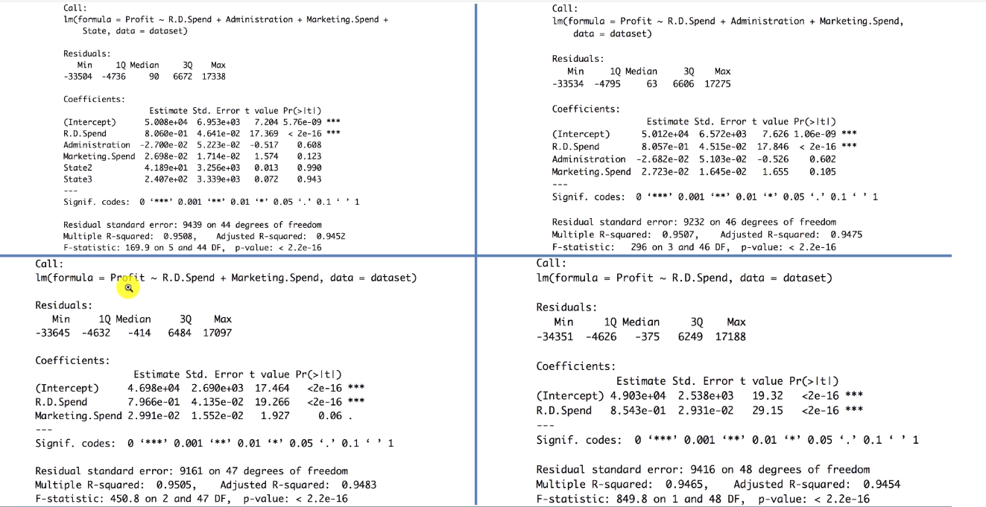
BEST OF ALL 4

